Slide 1
Clippers and Counterfeiters
Fakes and Forgeries Post-Visit Resource
To read about the Old Bailey please visit www.oldbaileyonline.org

Slide 2
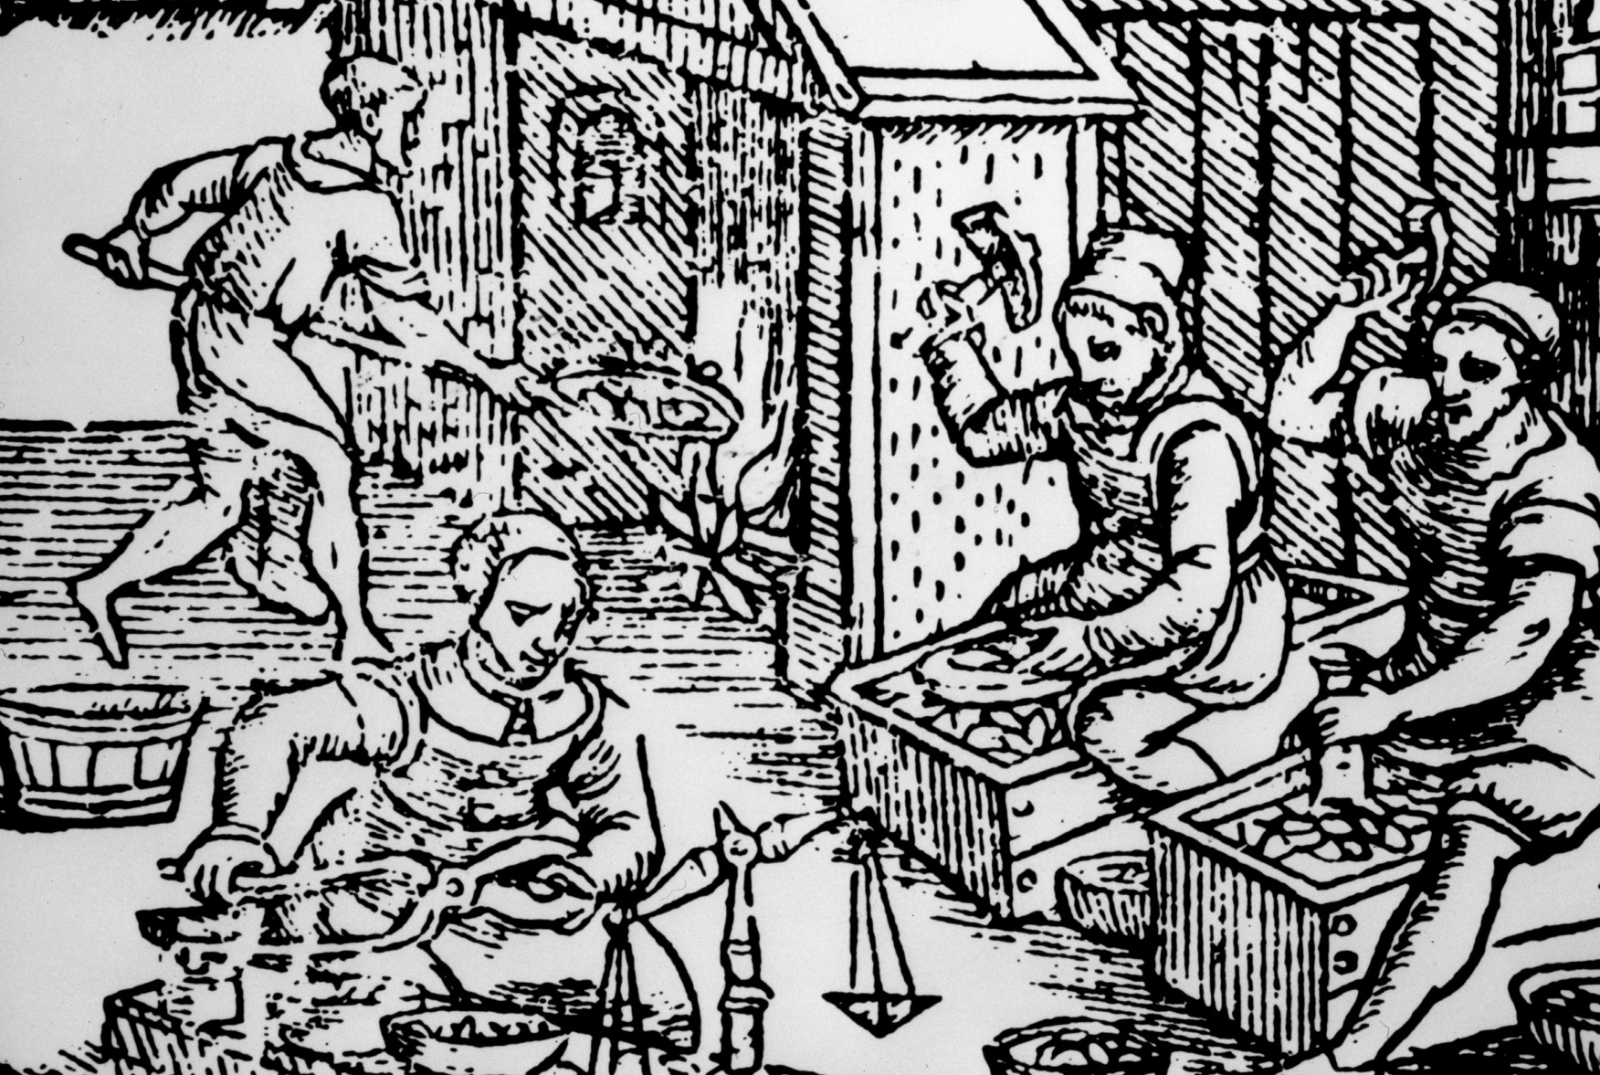
Before there were machines at The Royal Mint, coins were made by hand.
Designs were struck on to thin pieces of metal using a hammer and a pile and trussell.
1
Notes:
Minting coins with hand-held tools.

Slide 3
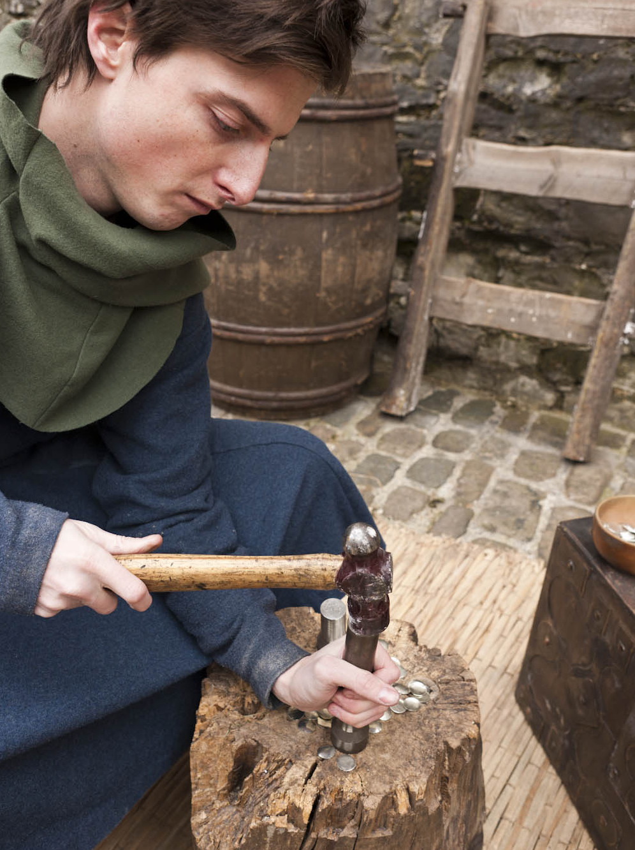
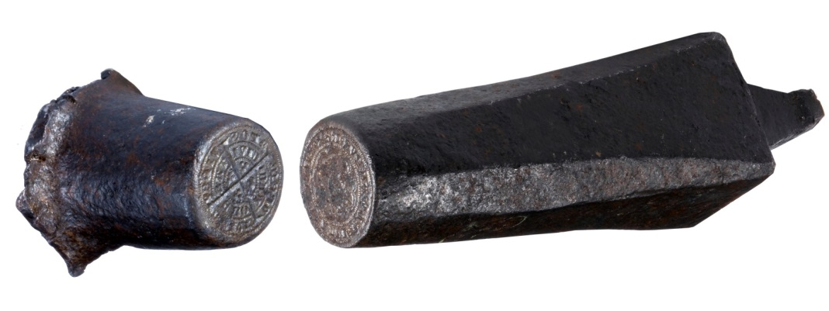
The metal used to make the coins was melted down and beaten into a sheet.
Discs of metal were cut out with shears. These were called BLANKS.
It was difficult to get all the blanks the same shape.
When they were struck with a pile and trussell the designs didn’t always reach the edge.
2
Notes:
Pile and trussell.

Slide 4
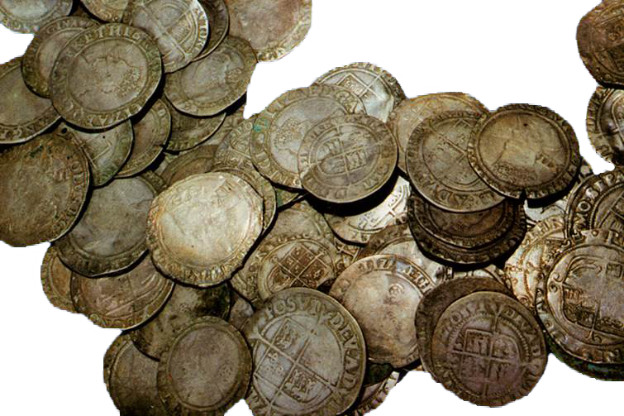
When machines were introduced, they made much better coins. They were thicker and had milled edges (vertical lines like on the 5p and 10p).
The old handmade coins weren’t recalled, so people used both the old money and the new machine-made money.
3
Notes:
Hand-struck coin

Slide 5
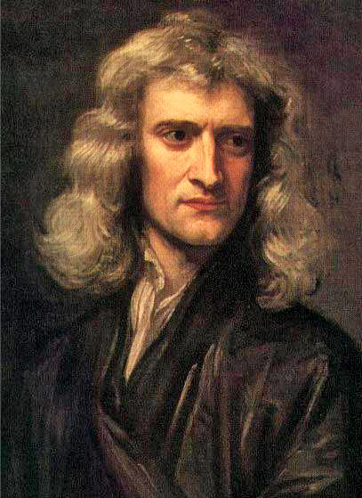
Sir Isaac Newton
Sir Isaac Newton was Warden
of the Mint from 1696–99.
His job was to make sure that the coins The Royal Mint made were of the highest quality.
He also set out to catch as many ‘coin criminals’ as he could.
He and other Royal Mint experts gave evidence in court when a counterfeiter was caught and put on trial.
4

Slide 6
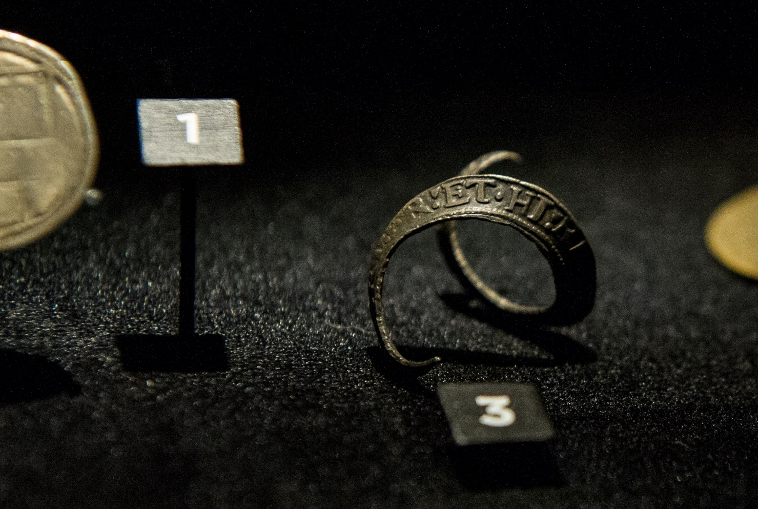
Coin Crimes
Clipping
Cutting bits of metal from the edges of coins.
Shaking coins together in a bag to make metal dust.
Counterfeiting
Making fake coins and passing them off as the real thing.
Taking low value coins and colouring them to make them look more valuable.
5

Slide 7
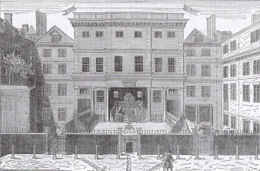
Coin crimes were High Treason.
If you were a suspect or suspected of committing a coin crime you would have been arrested and taken to court. In London you would have been taken to the Old Bailey.
The Court
6
Notes:
Old Bailey 1673
Open air court in a medieval building
Source www.oldbaileyonline.org http://www.oldbaileyonline.org/static/The-old-bailey.jsp

Slide 8
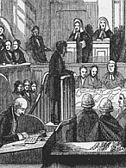
At Court
The Prosecution
Would have tried to prove that the suspect was GUILTY.
The Defence
Would have tried to prove the suspect was NOT GUILTY.
The Jury
Would hear the case.
The Judge
Would make the decision.
7
Notes:
Engraving of the trial of a highwayman. At first the Jury sat on both sides of the accused. http://www.oldbaileyonline.org/static/Gender.jsp

Slide 9
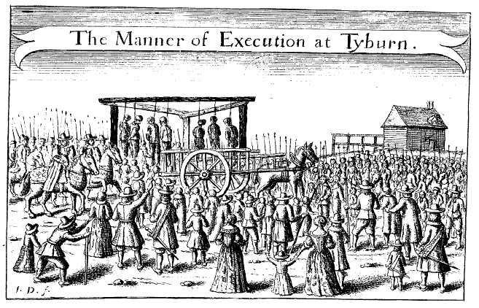
If you were found guilty you were likely to be sentenced to death.
Men were hanged and women were burned at the stake.
Tyburn (now Marble Arch in London)
8
Notes:
Hanging at Tyburn
Source: Getyimages

Slide 10
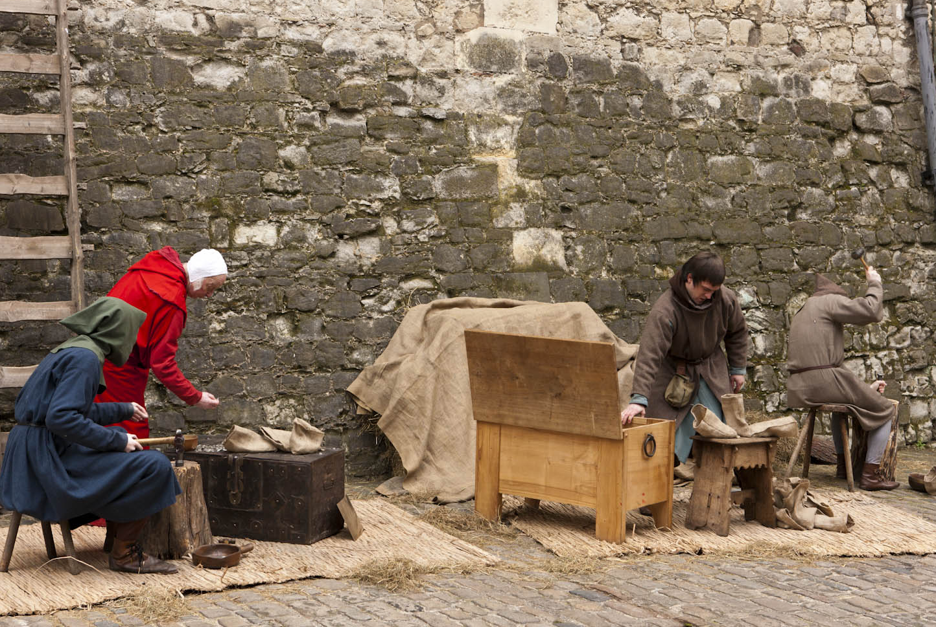
Role Play
9

Slide 11
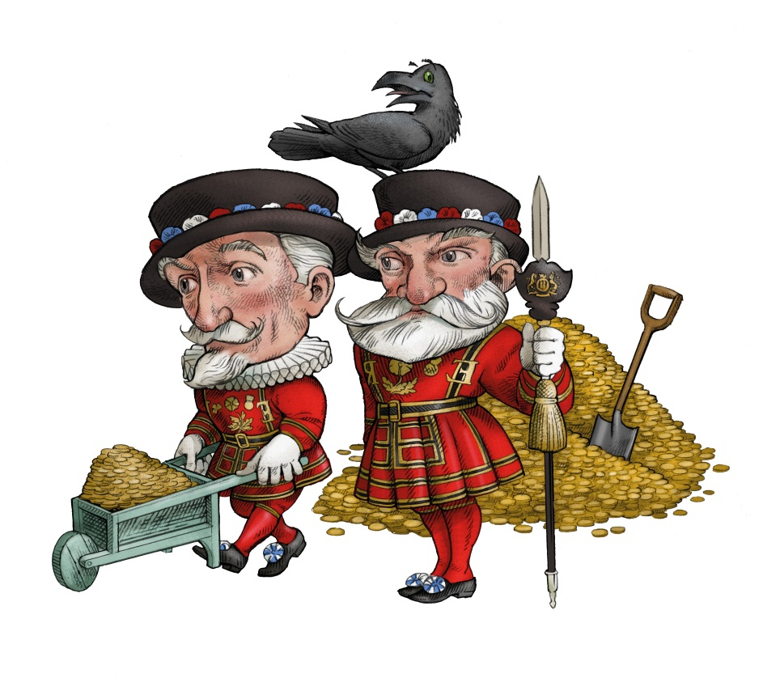
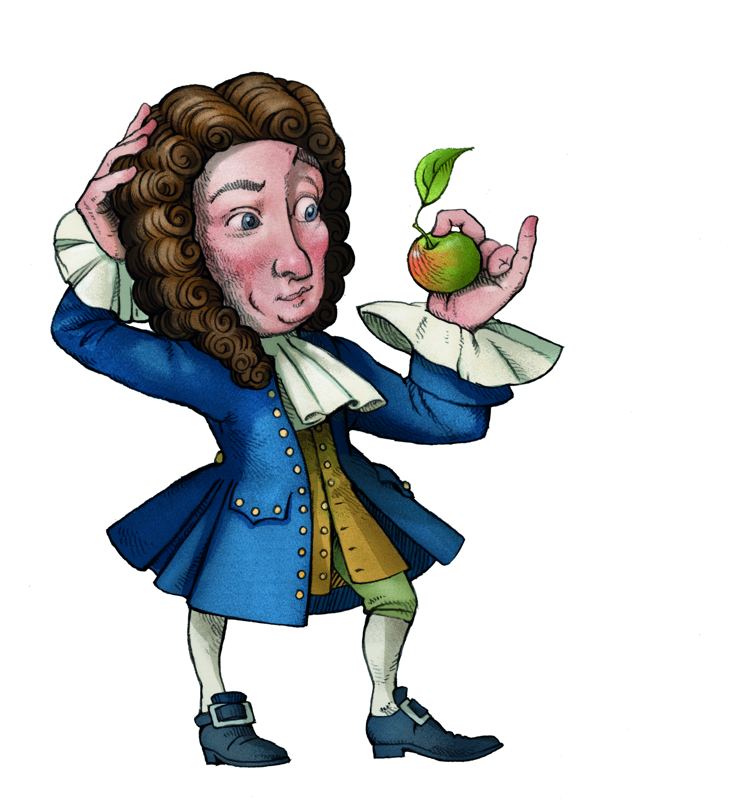
Characters
The Prosecution
The Constable
Informers
Witnesses
Royal Mint experts
The Defence
The Accused
Character witnesses
The Court
The Judge
The Jury
10

Slide 12
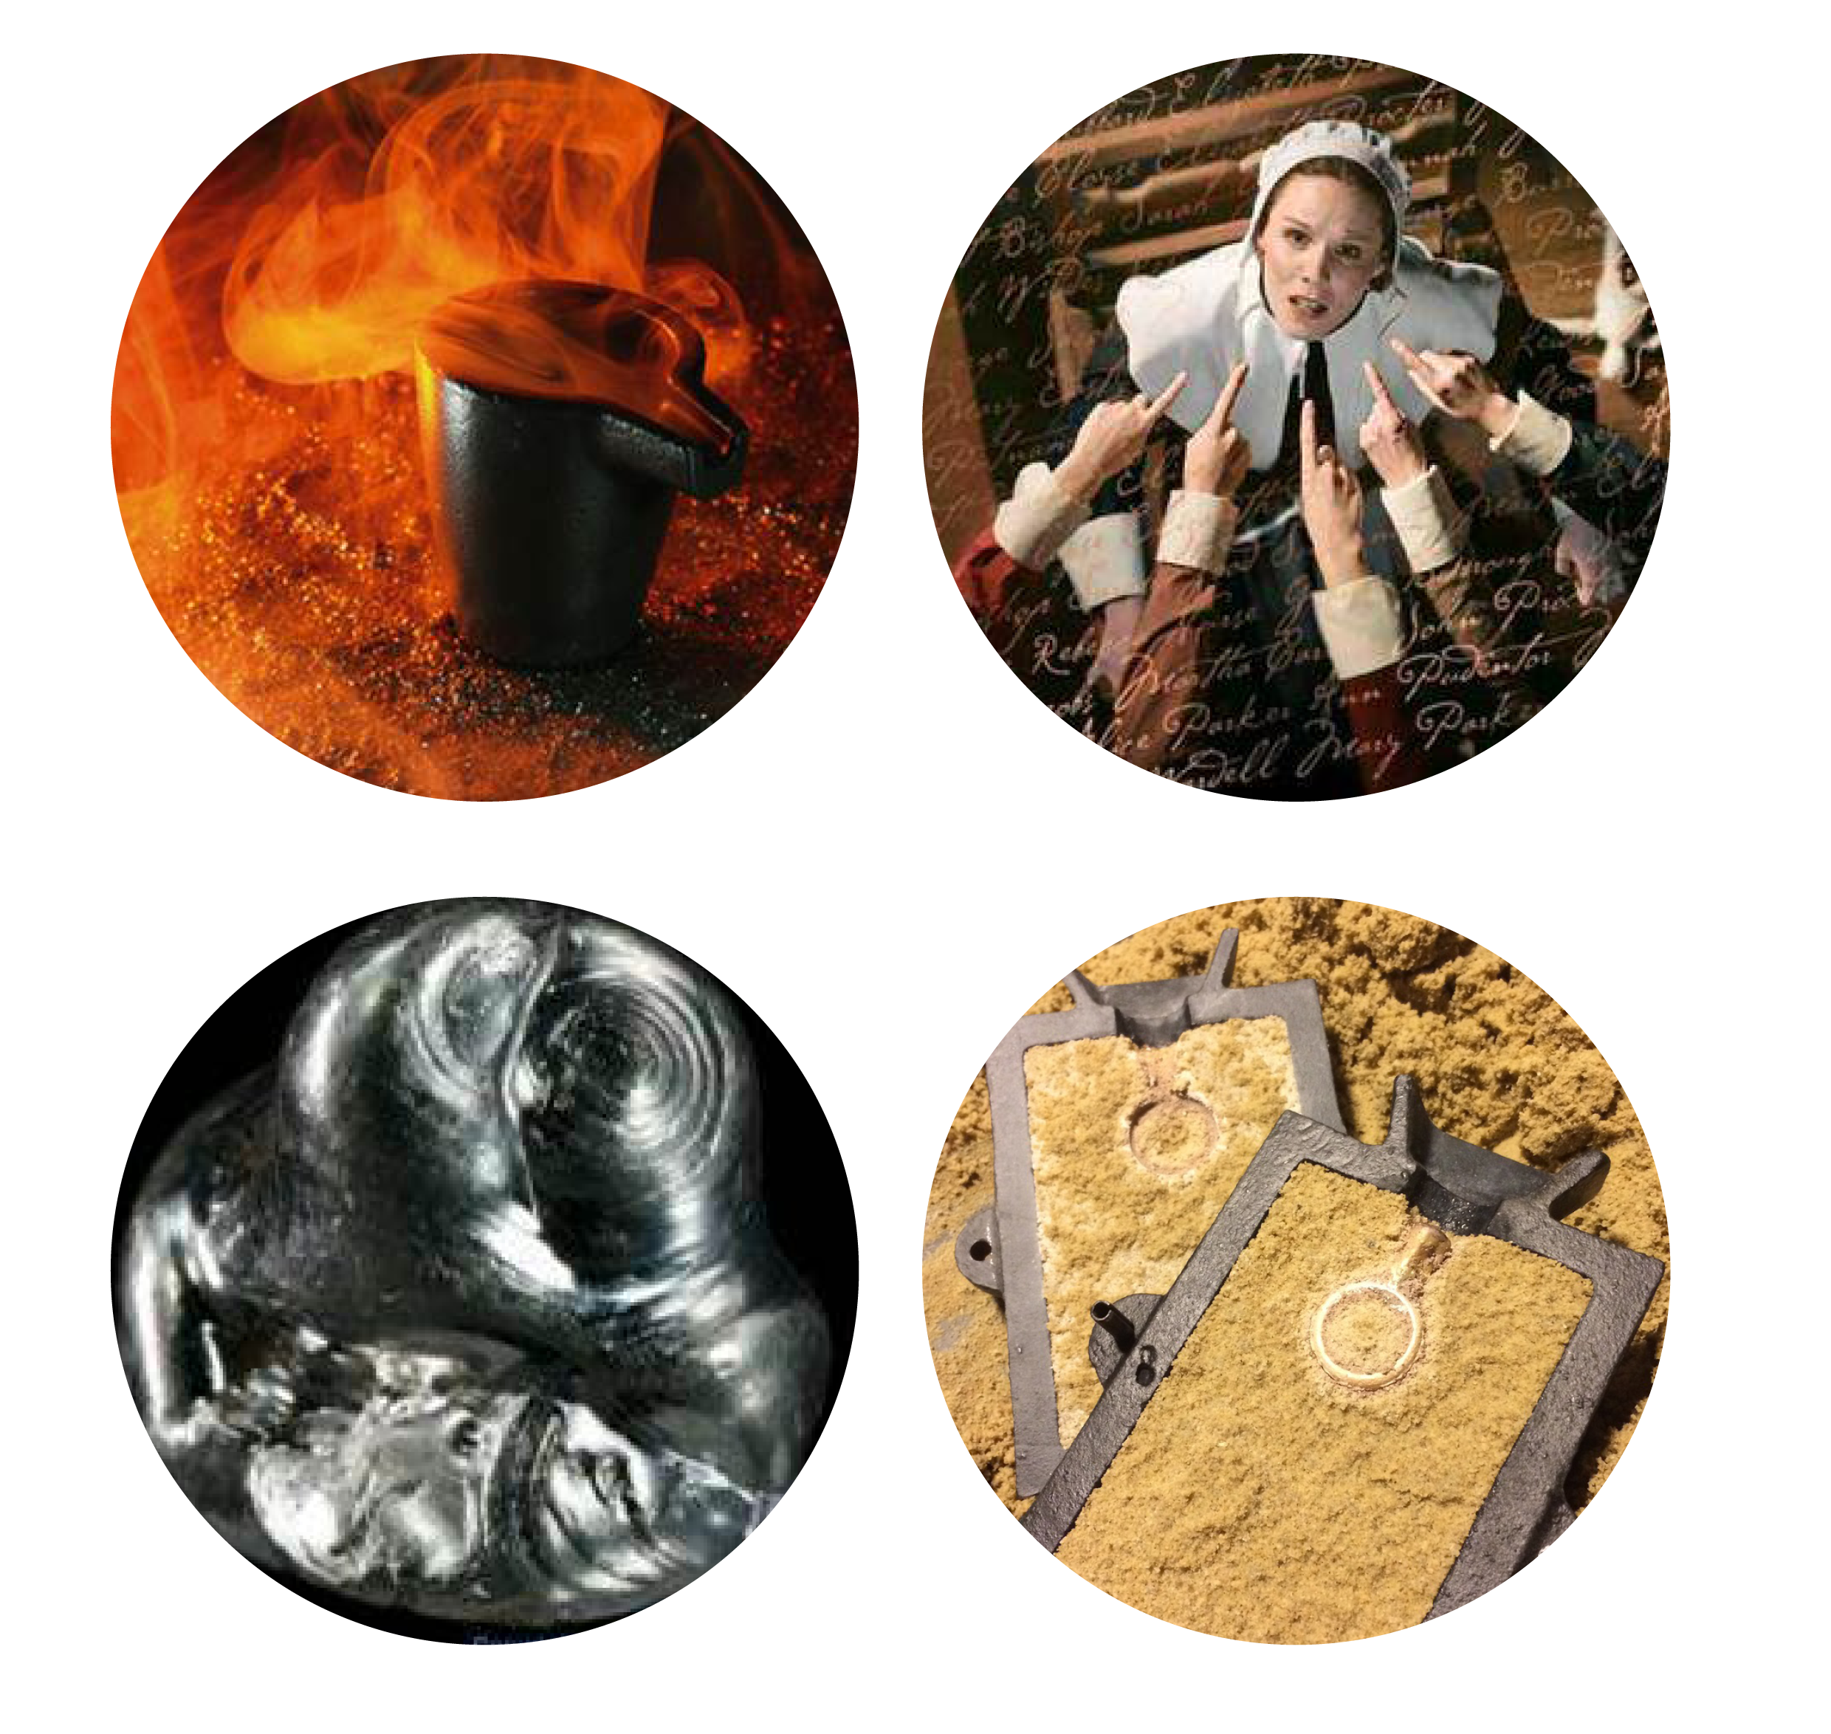
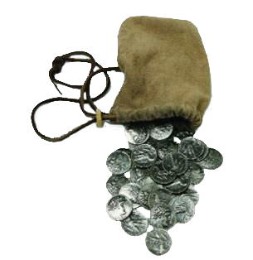
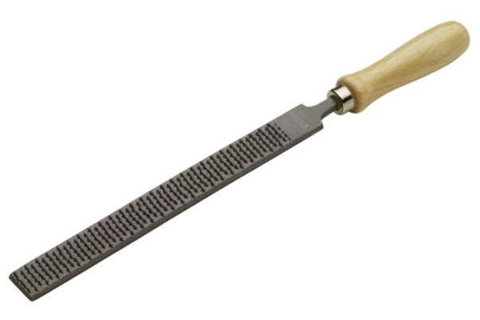
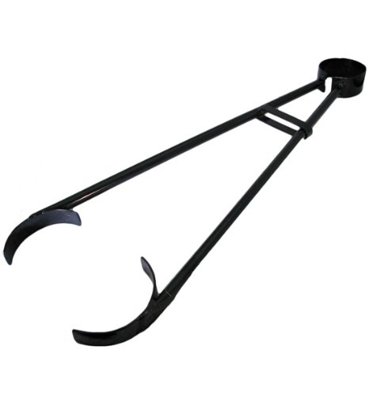
Items associated
with coin crime
Sand moulds
Forged coins
Files & Tongs
Crucibles
Metal
11
Notes:
Items of evidence for clipping and counterfeiting
Items:
Sand mould
Crucible(s)
Tongs
Metal file
Forged or clipped coins
Silver

Slide 13
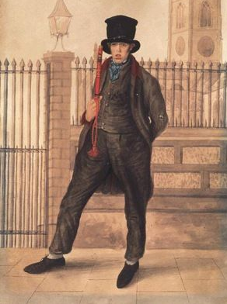
The Prosecution
The Constable might say…
he had found clipping or coining tools in the house, maybe under the bed or in a cupboard.
he had found counterfeit coins in
the house or in the person’s bag.
he had found coin clippings.
that the accused had tried to escape or did escape and was caught.
how the accused tried to hide or get rid of the tools they had been using and any other evidence.
12
Notes:
‘Policeman, Scarborough’ c 1830 by William Dempsey

Slide 14
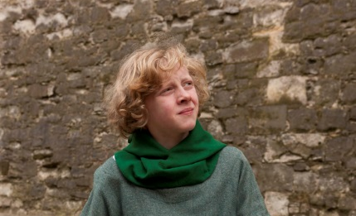
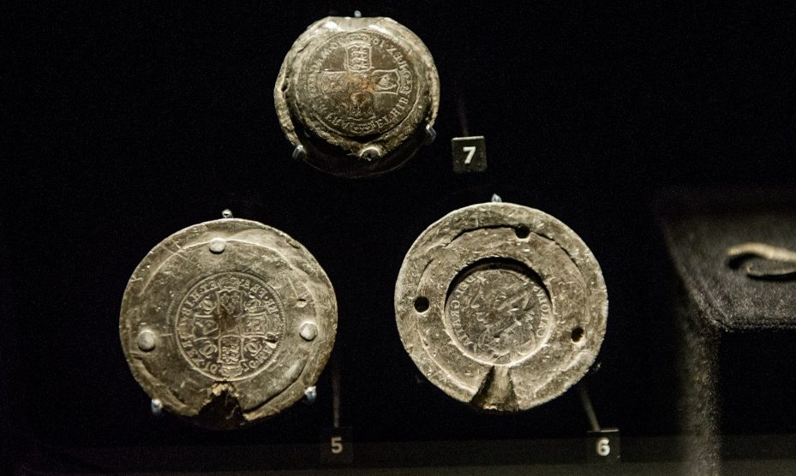
The Informers might say…
that the accused was a known counterfeiter or a member of a gang that made counterfeit money.
that they were a shopkeeper and the accused had bought the tools to counterfeit or clip coins from them.
that the accused had ordered tools that were made especially for clipping coins.
The witnesses might say…
the accused had given them fake coins, pretending they were legal.
that they saw the accused clipping or filing coins.
that they saw the accused using moulds or a press to make fake coins.
that what the accused said in their defence (why they were innocent) is not true.
13

Slide 15
The Experts might say…
that the tools could be used for coining.
that the fake coins they had found on the person had been made in the coin press they found at the house.
that the agree that the coins are counterfeit because they could tell that the workmanship was not as good
to the court that the coins were not made of the right metal.
14
Notes:
Sir Isaace Newton

Slide 16
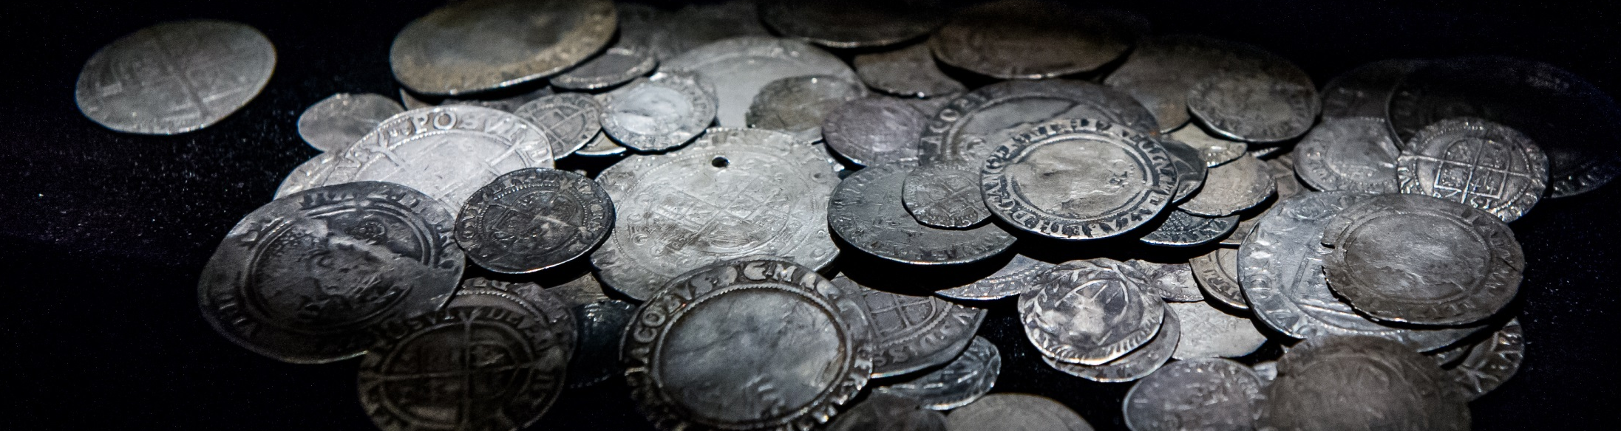
The Defence
The accused might say…
that the tools belonged to his landlady.
that the tools and other things did not belong
to them.
that they belonged to her husband, but that she could not tell the court his secrets.
that they have asked for people who knew them to speak to the court and say that they did not do it.
that the tools did belong to them but that they worked at home as a silversmith and it was legal for them to have them.
that he did not know anything about the equipment found in his house and that it might belong to his lodger (someone who paid money to live in his house with him).
15

Slide 17
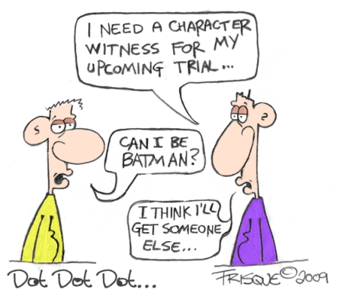
Character witnesses
might say…
that they had known the accused a long time and that they could be trusted.
that the accused story was true – that they were a silversmith and it was legal for them to own the tools.
that they were hardworking people with jobs who would not have the time to make counterfeit money.
that the accused was well respected in the community and was a good citizen.
Character witness
noun
A person who attests to another’s good reputation in a court of law.
16
Notes:
Cartoon by Graeme Frisque 2009

Slide 18
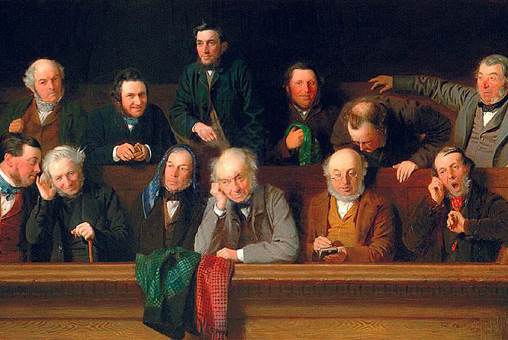
The Jury
Juries would have been made up of 12 men – in those times women were not allowed to be on a jury.
Only men aged between 21 and 70 who owned property (a house or land) that was worth more than £10 a year (a lot of money in the 17th century) could be jurors.
A person having counterfeit coins was not enough by itself to convict them as those coins could have been made by someone else. This meant it was important that a counterfeiter’s or clipper’s tools were produced in court.
17
Notes:
‘The Jury’ by John Morgan (1861)

Slide 19
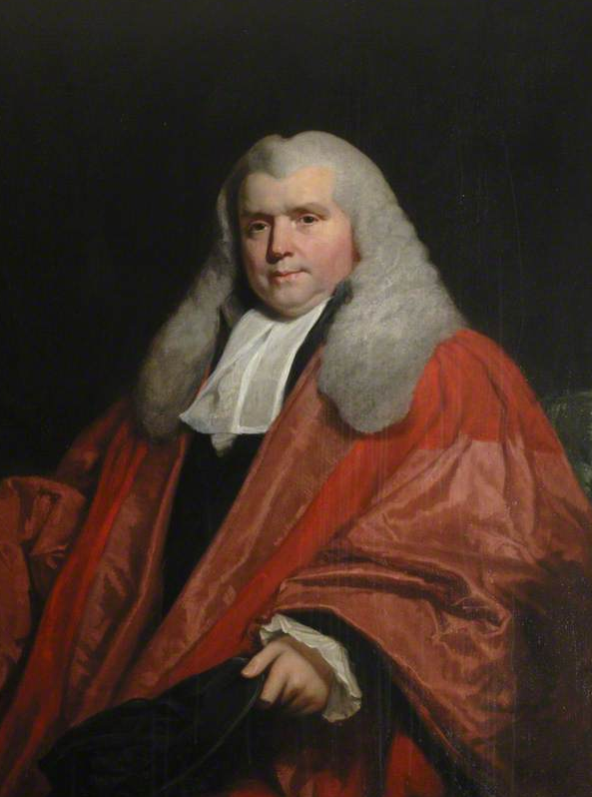
The Judge
A correctly-dressed judge would have worn a black robe faced with miniver
(a light-coloured fur) in winter and violet or scarlet robes, faced with
shot-pink taffeta, in summer.
The judge was in charge of everything that happened in the court and would keep everyone in check by saying “ORDER” if people got too noisy.
If he had to sentence someone to death he would have worn a black cap.
18
Notes:
Sir John Nicholl (1759-1838)

Slide 20
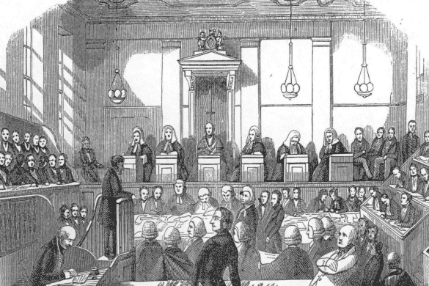
What would happen in court?
1. The constable brought the accused in front of the Justice of the Peace.
2. The aim of the prosecution was to try and prove that the person was guilty.
3. The accused would have defended themselves, trying to explain why the jury should believe they did not do it.
4. The expert witnesses would testify.
5. The character witnesses would testify.
6. The judge was in charge of everything that happened in the court and would keep everyone in check by saying “ORDER” if people got too noisy.
7. The jury would go away and decide whether the accused person was guilty or not guilty. When they returned the verdict would be given to the court and the judge would decide the punishment.
19

